Slide 1


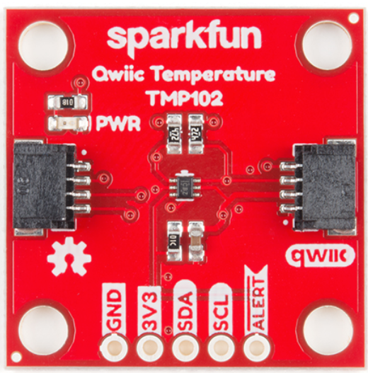
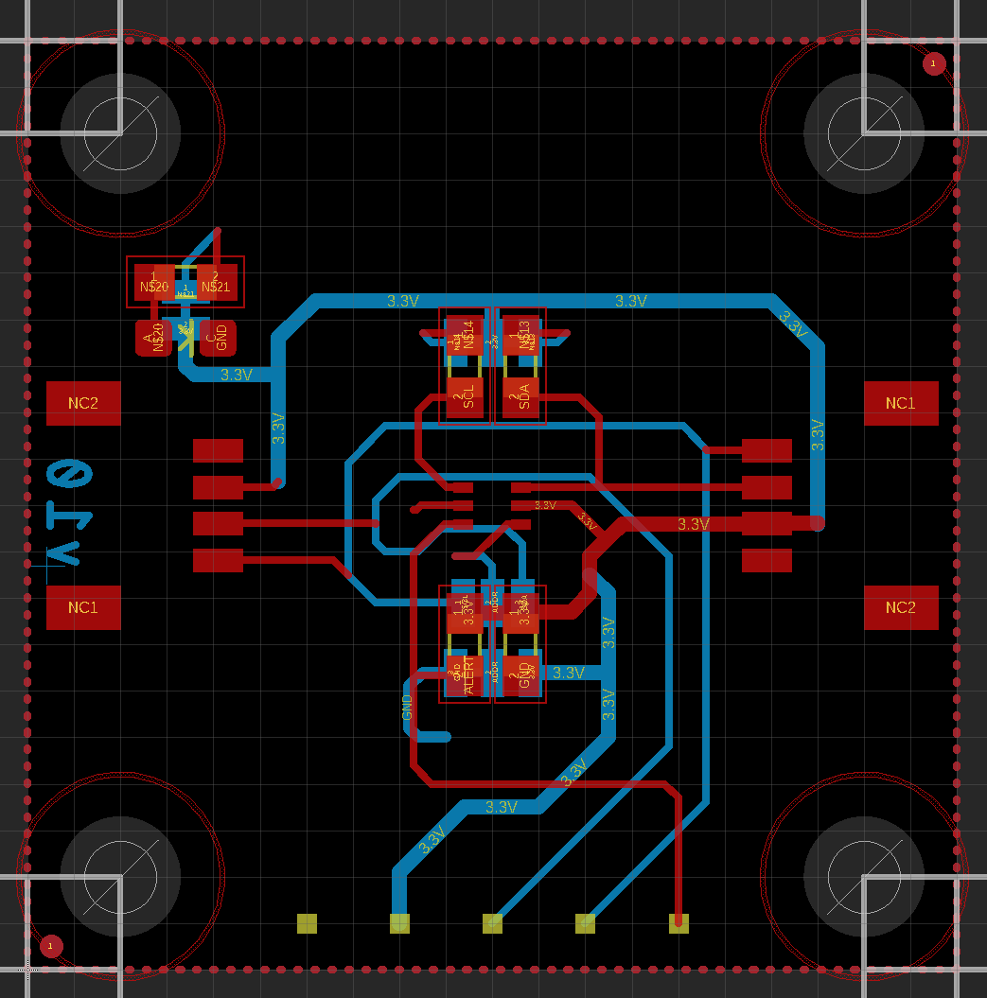
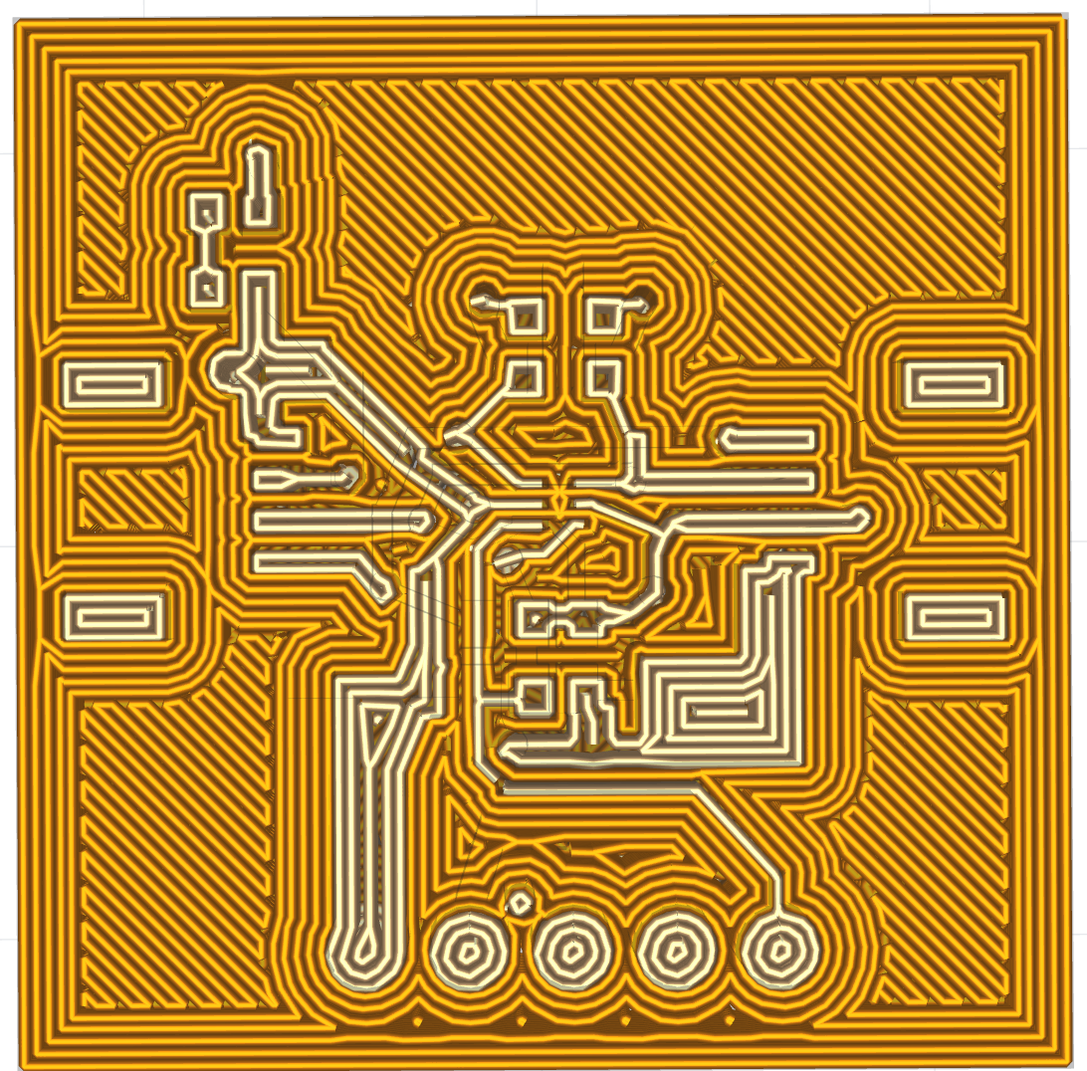
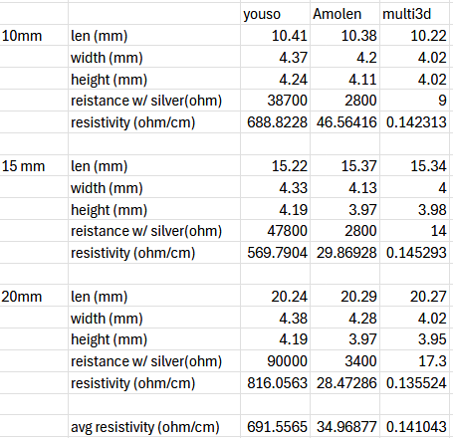
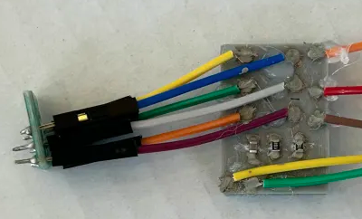
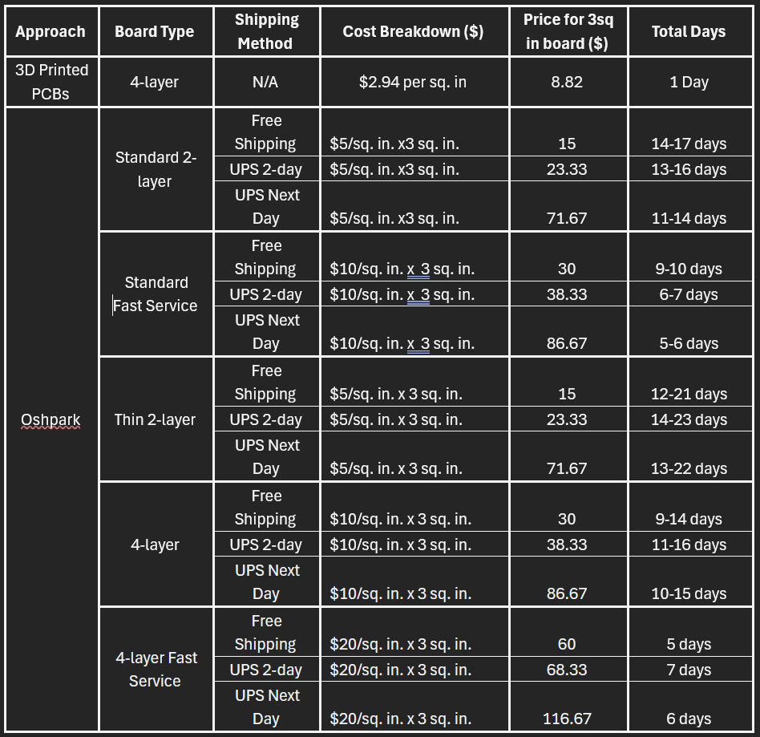

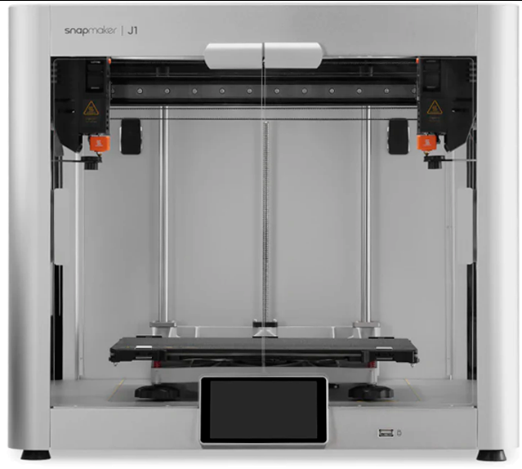
Affordable 3D Printing of PCBs for Prototyping DB&T Steven Naliwajka, Jevon Spinner, Michael Sarkar, Ngan Nguyen, Jarrod Ogle
Abstract
Design Flow
Resistivity Testing Data
This project explores the feasibility of producing PCBs with 3D printing using conductive filaments. It evaluates filament properties, mounting techniques, and challenges in conductivity, instruction formatting, and multi-layer design, aiming to establish a viable method for functional PCB fabrication.
Primer
While traditional PCB fabrication remains the go-to method for mass production due to its proven efficiency, 3D printed PCBs offer promising advantages for rapid prototyping, design flexibility, and customization. The traditional process is to design a circuit in a .brd (board) file, which is then converted into Gerber files for trace layout and Excellon drill files for vias and through-holes. These files are sent to a PCB fab shop, where the board is manufactured through processes like etching, drilling, and layer stacking.
The chip attempted to be replicated using the method of 3D printing a PCB is the SparkFun Digital Temperature Sensor – TMP102.
A photo of the .BRD file, photo taken in Autocad Eagle
A photo of the resulting GCODE, photo taken in the slicing program for the printer.
A photo of the final product. Components are electrically mounted using silver paste and physically held using super glue.
Problem Statement
Economic Analysis
Prototyping with traditional PCB fabrication is slowed by lengthy printing and shipping times, making iteration costly and inefficient. Additionally, standard processes often limit design flexibility, restricting unique form factors. These challenges hinder innovation, especially for small-scale projects.
200g MULTI-3D conductive filament: $200
1kg Regular PLA: $13
Silver paste # 12640 from Electron Microscopy Sciences: $90/vial
Design Statement
3D Printed PCBs (4 layer, 1in x 1in):
Cond. Filament: $1 per 1in. x 1in.board
Silver Paste: $1.80 per 1in. x 1in. board
Reg. Filament: $0.06 per 1in. x 1in. board
3D printer cost allocation: (Assume 10,000 boards made for lifetime use): $846/10,000 = $0.08/board
Price per 1"x1" board: $2.94
This project aims to design and implement a 3D printing solution for PCBs that reduces prototyping time, lowers costs for small-scale production, and supports unique form factors to enhance design flexibility and innovation. Additionally, the project evaluates various conductive plastic materials to identify optimal solutions for efficient and reliable PCB manufacturing.
Silver paste # 12640 from Electron Microscopy Sciences:
adds a resistance of .05 ohm when applied
Trace Resistance
3D-Printer
Using the Multi3D filament, a 10mm long trace using the smallest (.3mm x .3mm) square size is about 156.67 ohms. Resistance only drops as your trace area grows
10mm is the longest trace on our demo board.
What's stopping innovation now?
Traditional PCB manufacturing is subtractive, involving the etching away of unwanted copper using light-activated acid to leave desired circuit traces.
3D printing, on the other hand, is additive, involving the laying down of plastic traces.
Because subtractive processes rely on light without depth, traditional toolpath information often includes overlapped traces. This prevents a straightforward 1-to-1 conversion from traditional methods to 3D printing.
To create a working copy of the TMP102 board, the traces were manually re-created using a CAD model.
Currently, to the best of our knowledge, there is no existing converter capable of handling the conversion of Gerber and Excellon files into G-code for multi-layered boards. To address this challenge and simplify future workflows, the file converter "FabFormat" is being developed. What began as a basic concept inspired by Dr. Grosch has evolved into a sophisticated and powerful tool, now 80% complete and consisting of 5.3K lines of Python. The ambitious goal of supporting complex curves and fully handling all Gerber commands has delayed its completion beyond the senior design expo. While not feature-complete today, the project is available on GitHub under the name "FabFormat" and continues to progress toward its goals.
Assembly Process
Conclusion
Multi-3D conductive filament and silver paste #12640 are chosen due to the low resistivity. The filament does not print well below .3mm. While the resistivity would allow traces smaller. The conductive filament requires traces and spaces between traces to be .3mm at a minimum.
Once the board is printed, silver paste is applied to the mounting points to remove contact resistance and to serve as substitute solder.
Components are then mounted and tacked into place using super glue as the binder.
To get the best resistivity, the board needs to set for a few hours to allow the filament to cool and the paste to dry.
Traditional PCB fabrication involves multiple steps such as designing the circuit. This process can take several days to weeks, depending on the complexity and the number of layers, with costs generally ranging from $10 to several hundred dollars for small to medium-sized orders, depending on factors like the board’s complexity, size, and quantity.
On the other hand, 3D printed PCBs offer faster prototyping and design iteration, generating Gerber and Excellon files, etching copper, and drilling vias and through-holes. The printing process can take hours, significantly reducing lead times. However, 3D printed PCBs tend to have higher initial costs due to the need for specialized printers and materials. While the price per unit can be higher, 3D printing can be more cost-effective for small batches or custom designs, reducing the need for expensive tooling and setup fees.
Overall, while traditional PCBs are typically more suitable for mass production, 3D printed PCBs offer advantages in rapid prototyping and design flexibility, especially in industries where speed and customization are essential.
A Snapmaker dual nozzle 3d printer was used for the printing of the PCBS.
Future Research
Acknowledgement
"FabFormat" to automate generating printing instructions.
Improving conductive plastic tech to handle a smaller nozzle and have an even lower resistivity.
Dr. Cyril Okhio – Senior Design Professor
Dr. Theodore Grosh – Senior Design Professor
Shengrong Ye (Multi3D) – Donated 100 grams of Multi-3D conductive filament

